Slide 1
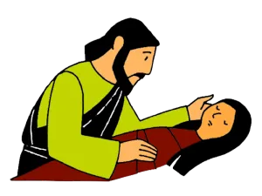
Class -2, Moral Science
Lesson 9: Jesus Raised A Dead Girl
Lesson content prepared by Miss Imlikala, Matron cum Teacher. Revised and Edited by Madam Nini Sekhose, Chairman LSHSS

Slide 2
Story overview
A synagogue ruler named Jairus had a little girl who was dying. He begged Jesus to come to his house and heal her. Jesus agreed to accompany Jairus but was detained when he stopped to heal someone else. Meanwhile the girl died. When Jesus arrived at the house he told the mourners that the little girl was not dead but just “asleep.” They laughed at him. Then, everyone was astonished as Jesus raised Jairus’ daughter from the dead.

Slide 3
Background story:
Many of the Jewish leaders did not follow Jesus. These leaders were very angry that Jesus was teaching things that were so different than the things they taught. Jesus had been teaching on the other side of the Sea of Galilee, and now He was on His way back. When people heard that Jesus was returning, they crowded at the shoreline. Jairus was one of these people. His problem was so urgent, he probably paced back and forth waiting to catch a glimpse of Jesus’ boat heading to shore.

Slide 4
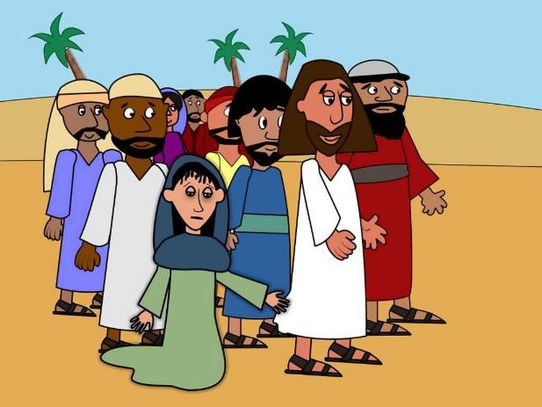
Introduction:
Have you ever had a big, big problem? Have you ever needed Jesus so much?
Today we are going to learn about two people who came to Jesus with a need that only He could help them with.
Let’s read Mark 5:21

Slide 5
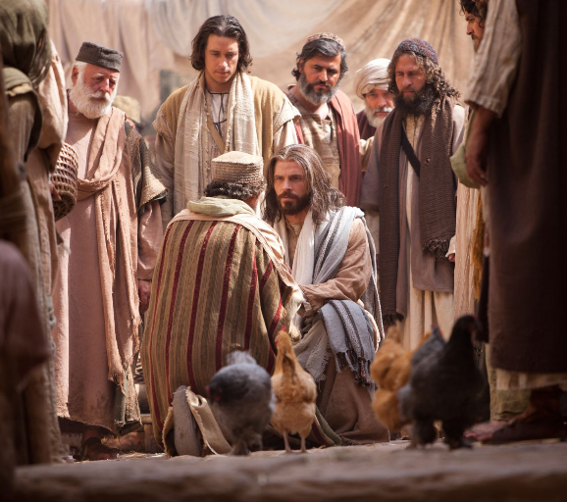
Jairus Come to Jesus (Text)
One day Jesus and His disciples were walking through a village. There were crowds of people around Him.
A man came running up to Him. His name was Jairus. He was in charge of the meeting place, called the synagogue.

Slide 6
Let’s expand:
Jesus had become very famous by now, but He was still very approachable. (He was God not man that He should let fame go to His head.)
On this day He arrived on the shore of Capernaum. Crowds of people saw Jesus on the shore and they gathered together to see Him.
Have you ever been in a large crowd to see someone important? It is hard to get close to that person isn’t it? Imagine being in the crowd on that day.
In our story the two people I mentioned earlier desperately needed to get to Jesus. They both had needs that they believed He could meet.

Slide 7
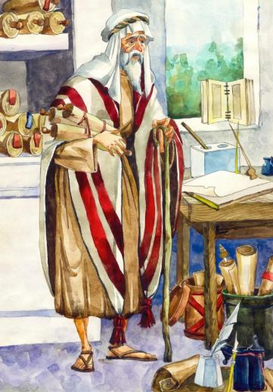
Who was Jairus?
Jairus was an important man. He was the leader of the synagogue. The synagogue was the place where the Jewish people worshipped God. Many of the Jewish leaders didn’t like Jesus or believe He was the Son of God. Maybe Jairus was a secret follower of Jesus.
When his daughter was dying, it was not the Synagogue leaders he ran to, but it was to Jesus. In our most painful moments, we run to the person we trust most. Children run to their mothers.

Slide 8
On the way, a sick woman touched Jesus: (Text)
Jairus was unhappy because his little girl was very sick. He begged Jesus, ‘’Please come to my home and heal my child before she dies.’’ Jesus was going with Jairus but on the way a sick woman touched Him. She had been sick for twelve years. She would be well. She believed that, if she touched Jesus, she would be well. She touched the tassels on His prayer shawl and she became well.

Slide 9
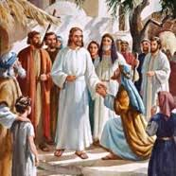
Let’s Discuss:
Jairus is desperate. Though the synagogue leaders do not believe in Jesus, he risks their disapproval by going to Jesus. Jesus is very gracious. He does not say, “You are not from my group, you are from the group of people who don’t like me, I cannot come.” No, He follows Jairus to his house.
Jairus kneeling before Jesus.
Jesus is attracted to faith. Where there is faith He responds. It doesn’t matter who you are or what you have done. It only matters that you need Him and you trust Him.

Slide 10
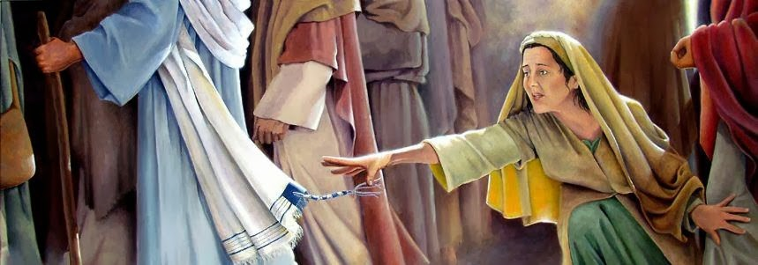
Faith Comes by Hearing …..
But on the way a woman who was sick for 12 years and had spent everything she had on doctors, saw Him in the crowd and ran to touch His garment.
She had heard so much about Him. She pushed through the huge crowd which was almost crushing Jesus, reached out in faith, touched His garments and she found herself healed! She was overjoyed. But let’s read further….

Slide 11
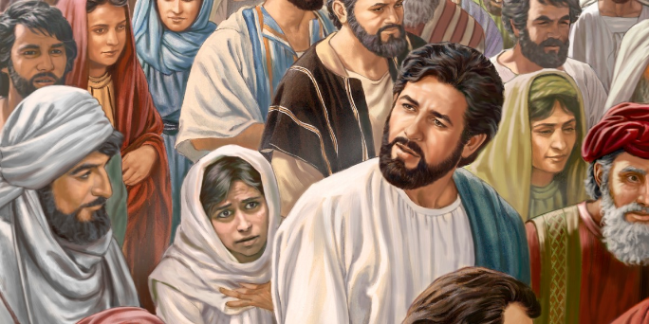
“Power Has gone out of Me.”TEXT
Jesus stopped. ‘’Who touched me?’’ He asked. The disciples thought He was being silly.
“Who touched Me?”
Everyone’s touching you,’’ said Peter. ‘’No.’’ said Jesus, ‘’I felt power going out of me.’’ The lady who had been healed was afraid. She thought Jesus would be angry with her for touching Him. She came out of the crowd and owned up. ‘’I touched you,’’ she said. Jesus spoke gently to her. ‘’You are healed because of your faith,’’ He said. ‘’Go in peace.’’

Slide 12
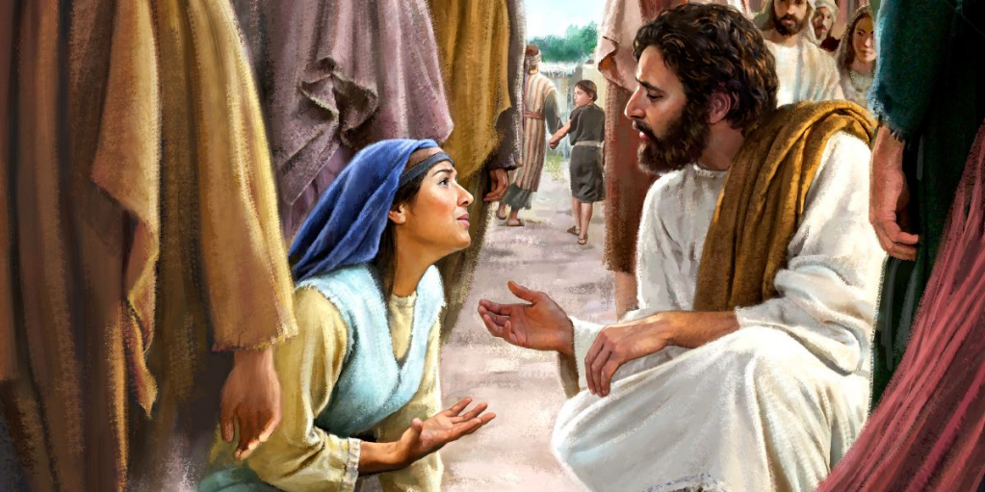
A Walking Power Station
Can you imagine being filled with so much of God’s power that when that power leaves your body, you sense it? That is what happened that day. Jesus felt power leaving His body! Jesus was a walking power station!
Jesus Christ is the same, yesterday, today and forever..Hebrews 13:8
Memory Verse.

Slide 13
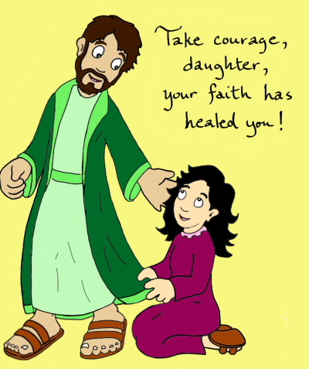
A lesson to learn:
When Jesus asked ‘Who touched Me?” The woman was afraid. But she did not hide and run away. She stepped forward and told the truth.
Jesus spoke to her praised her faith and told her she was healed.
She could have run away, she was afraid. No one would have known. But she did not. We should learn to face our fears. Sometimes we miss good things happening to us because we run away out of fear. Always be truthful.

Slide 14
How to Honour Jesus
When we come to God in prayer it is important that we remember that God is holy and worthy of our respect. One way we can show Him honor and respect is to pray on our knees. Bowing down before God shows Him great honor.
Jairus believed that Jesus could heal his dying daughter and was pleading with Him to come to his house. When a person believes God can do something that is faith. Faith pleases God.
Memory Verse Hebrews 11:6 “ .. without faith it is impossible to please God..”

Slide 15
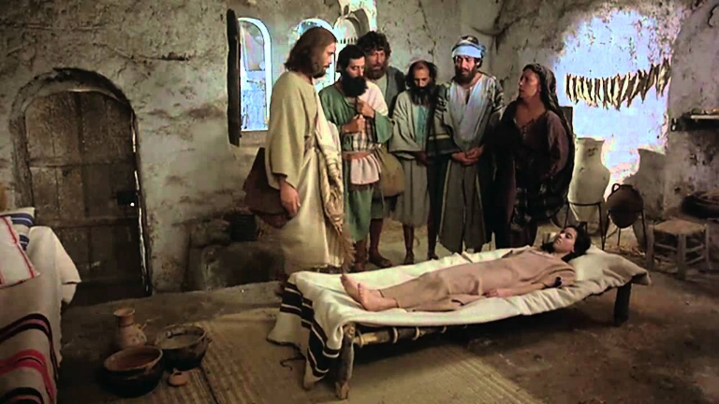
Assignment
Write the answers in your copy and photograph, send to Google classroom. Write your name on the page with class and roll number.
Whose daughter was sick?
What happened on the way to Jairus’ house?
Why did Jesus ask “Who touched Me?”

Slide 16
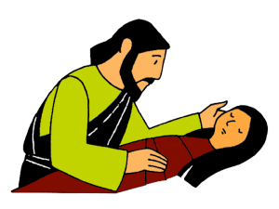
Class-2 Moral Science
Lesson-9 Jesus Raised A Dead Girl.
Part - II

Slide 17
“Your Daughter is Dead (Text)
Some people came from Jairus’ home. ‘’Don’t bother Jesus,’’ they told him. ‘’Your daughter is dead.’’ Jairus was very upset. Jesus comforted him. ‘’Don’t be afraid,’’ He said. ‘’Just trust me.’’ They hurried to Jairus’ home and found many people wailing and crying because the little girl was dead. He told them she was not dead, only sleeping. They laughed at Him. ‘’We know she’s dead,’’ they said.

Slide 18
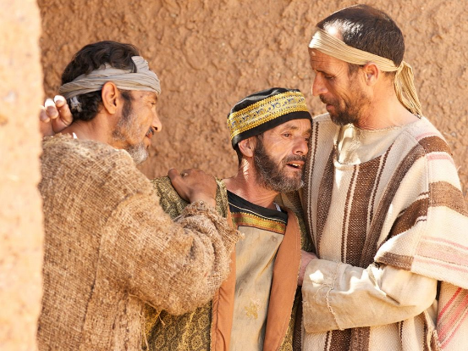
Let’s Discuss:
Jairus had wanted to Jesus to come and heal his daughter on her deathbed. When he heard she had died he became very sad. At one point he may have lost all hope.
Jairus on hearing about his daughter’s death.
Jairus had witnessed a wonderful miracle on the way. He had hoped so much. But then suddenly he heard Jesus’ comforting words. To his surprise, Jesus had not given up. Jesus told him to not be afraid, but to trust HIm. Jairus’ faith was lifted up. He dared to believe the impossible.

Slide 19
Those people who brought the news to Jesus thought that it was now useless to bother Jesus to come. There was nothing Jesus could do anymore, they thought. But Jairus listened to Jesus instead of to them.
Sometimes in our lives we may be tempted to believe those who say God can do nothing for us now, but like Jairus we should listen to God and not to those who think God is powerless to save us from our troubles.
Read your Bible and take the promises of God to your heart. For e.g. during this virus time read Psalm 91:1,2. God will protect you from all harm.

Slide 20
You Are Protected by God

Slide 21
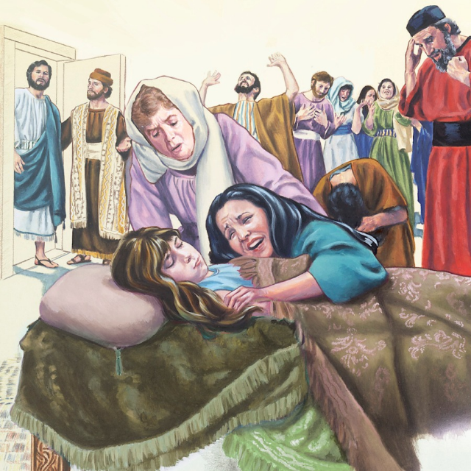
Believing in the Impossible.
They reached the house of mourning. Everyone was crying and wailing. They did not understand that God was in that house of mourning and He could do anything. They mocked Jesus when He said the girl was only sleeping.
But Jairus dared believe the impossible. Jesus saw his faith. He told everyone to leave the room.

Slide 22
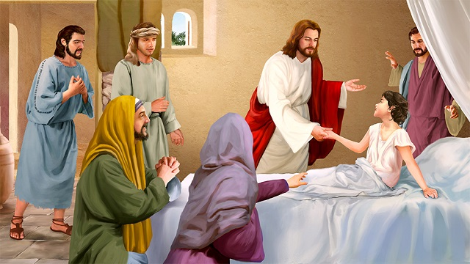
Jesus had raised the little girl: (Text)
Jesus told them all to go outside. He took the child’s father and mother and Peter, James and John into her room. Then he took her hand and spoke to her. ‘’Little girl,’’ He said, ‘’get up.’’ She opened her eyes and sat up. How happy her parents were! Jesus had raised their little girl up and she was alive and well.

Slide 23
Let’s discuss:
Jesus didn’t let what they thought of Him bother Him or keeping Him from showing His great power and love for Jairus and his family. He sent all the people out of the house except for Jairus and his wife and Peter, James, and John. They went to the room where the little girl’s body was lying. Jesus reached out took the girl by her hand. He spoke to her and said, “Little girl, I say to you, arise.” Immediately the girl got up and walked around the room. Jesus said to give the girl something to eat. Jairus and his wife were amazed! Their daughter who was dead was now alive!

Slide 24
Our God is the God of the Impossible
We have witnessed two very great miracles. The healing of the woman who was sick for 12 years and the raising from the dead of Jairus’ daughter.
Jesus performed so many miracles while He was on earth to tell us today that we can come to Him with any problem we face. He is Lord even of the virus. Only believe.
John 21:25 “Now there are many other things that Jesus did, if they were all written down one by one, I suppose that the whole world could not hold the books that would be written.”

Slide 25
God the Father is like Jairus in our story. He loves us and doesn’t want us to die and be separated from Him. God the Father loved us so much He sent His own Son Jesus to die on the cross for our sins. He was buried and three days later God the Father raised Him from the dead. Jesus died in our place so we don’t have to be separated from God.
Prayer.. “Dear God, thank you that Jesus was able to make the girl alive again. Thank you because Jesus is the God of the impossible, all things are possible. I love you Jesus. Amen.”

Slide 26
How well do you remember the story? (P-25)
What was the name of the man who asked Jesus to come and heal his daughter?
a) Samuel b) Jairus c) Joseph.
2. Why did the lady touch the tassels of Jesus’ prayer shawl?
a) She was sick
b) She was blind
c) She was deaf.
3. How did Jesus know that someone had touched Him?
a) He felt her pull on His robe.
b) He saw her crawling behind Him.
c) He felt power go out of Him.

Slide 27
4. What did the people who come from Jairus’ home tell him?
a) Your child is dead.
b) Your child is better.
c) Tell the Master to come quickly.
5. What did Jesus say to the little girl?
a) Little girl, wake up.
b) Little girl, go to sleep
c) Little girl, get up.

Slide 28
Answer the following Questions:
Q1. Who came to Jesus and fell at His feet?
Ans: Jairus.
Q2. What did Jairus ask Jesus to do?
Ans: Jairus asked to come to his house and heal his daughter who was very sick.
Q3. Why did the woman touch Jesus’ clothes?
Ans: She believed she would be healed if she just touched His clothes.

Slide 29
Q4. What happened to Jesus when she touched His clothes
Ans: Power went out of Jesus’ body.
Q5. What did Jesus say caused her healing?
Ans: Jesus said her faith had healed her.
Q6. What does this lesson help us to understand?
Ans: This story helps us to understand that no problem is too big for Jesus.

