Slide 1


Class: 3
Mathematics (Part 2) Page: 27 to 35
Add or subtract mentally pairs of two-digit whole numbers; refine and use efficient written methods to add and subtract two- and three-digit whole numbers and £.p
Mental and informal methods of addition and subtraction
Wtitten methods of addition and subtraction
Created by : Ratnadeep Chatterjee.

Slide 2
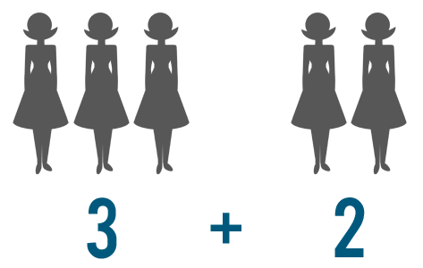
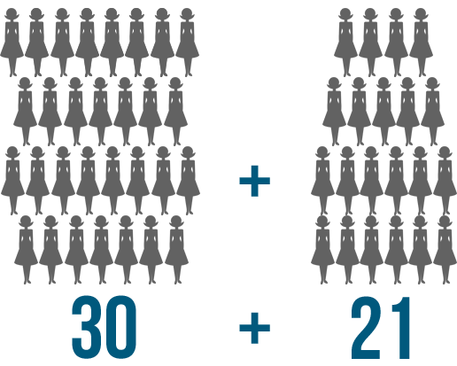

Importance of wtitten methods
We can often use counting and visuals to solve basic addition problems. For instance, imagine that 3 people are going on a trip and 2 more decided to join. To find out how many people were going total, you could represent the situation like this:
What if you have a bigger problem to solve? Imagine that a few groups of people are going somewhere together. 30 people travel on one bus, and 21 travel on another. We could write this as 30 + 21.
Once you look at the problem visually, you can count and see that 5 people are going on the trip.

Slide 3
Importance of wtitten methods
It might not be a good idea to solve this problem by counting. First of all, no matter how you choose to count, it would probably take a pretty long time to set up the problem. Imagine drawing 30 and 21 pencil marks on the page, or counting out that many little objects! Second, actually counting the objects could take long enough that you might even lose track.
For this reason, when people solve a large addition problem, they set up the problem in a way that makes it easier to solve one step at a time.
Here, in this presentation we’ll recall all the mental methods and informal methods we have learned already in lower classes and then discuss about the secure wtitten methods for addition and subtraction.
This can be summarized like this:
Can I do it in my head using a
mental strategy?
Could I use some jottings to
help me?
Should I use a formal written method to
work it out?

Slide 4
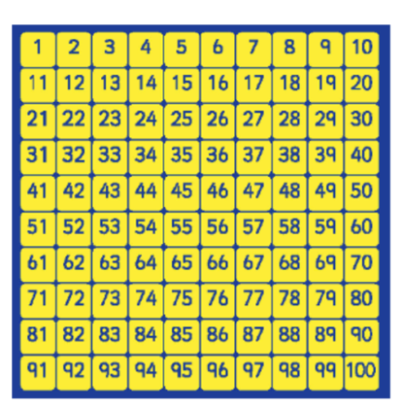
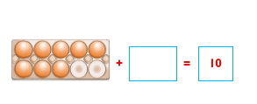
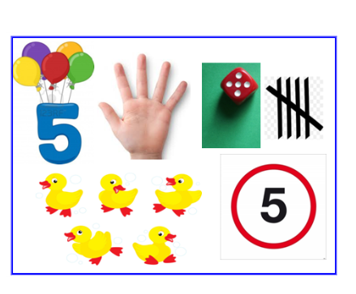
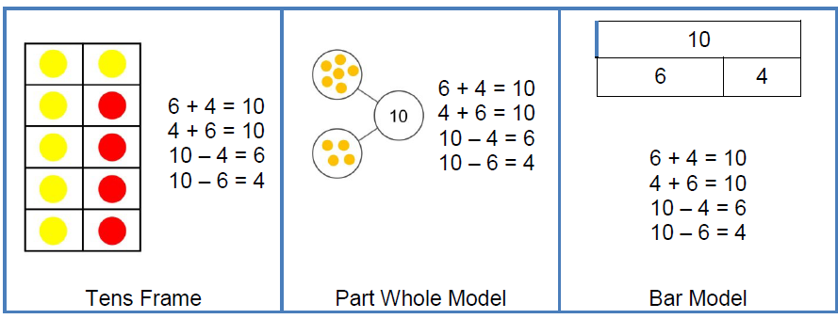
Addition
We can count on in ones to and across 100 and find one more than a given number.
We learned how to Identify and represent numbers using objects and pictorial representations (multiple representations)
We also learned to memorise and reason with number bonds to 10 and 20 in several forms.
6 + 4 = 10

Slide 5
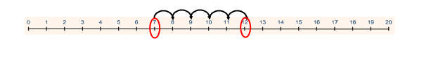
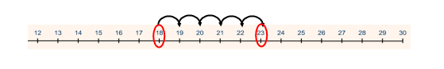
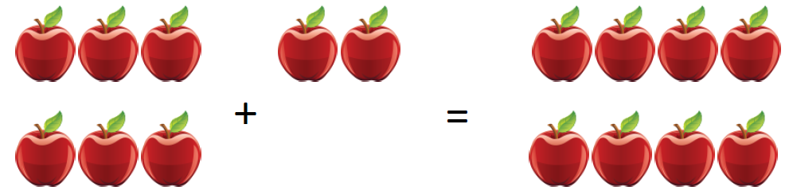
Addition
We have used concrete resources and a number line to support the addition of numbers. Know and use strategy of finding the larger number, and counting on in ones from this number.
Now we can solve one-step problems using concrete objects and pictorial representations.
1 digit + 1 digit
7 + 5 = 12
Tom picks 6 apples and Raj picks 2 apples.
How many apples do they have altogether?
2 digit + 1 digit
18 + 5 = 23
We begin to use the + and = signs to write calculations in a number sentence.

Slide 6
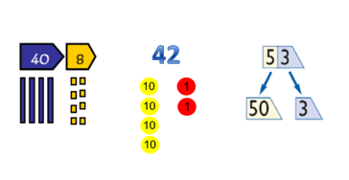
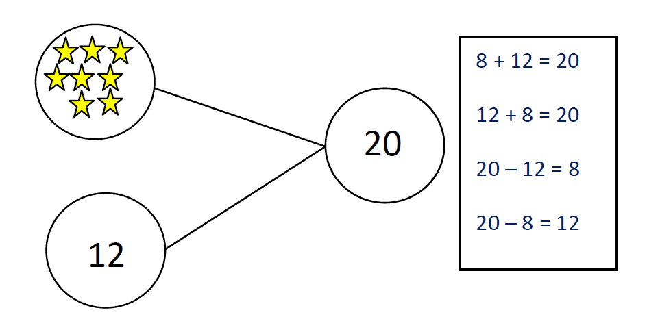



Addition
Memorise and reason with number facts to 20 in several forms.
Partition two 2-digit numbers using a variety of models and images.
32p

Slide 7
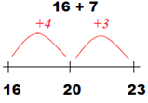
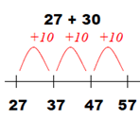
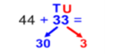
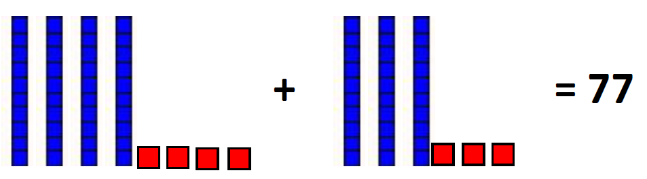
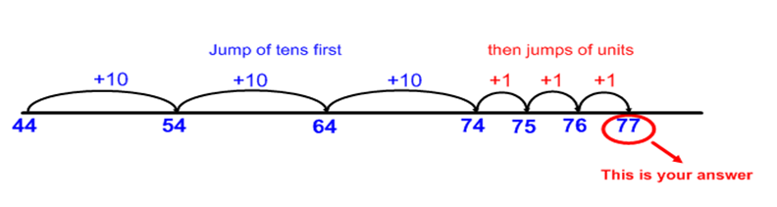
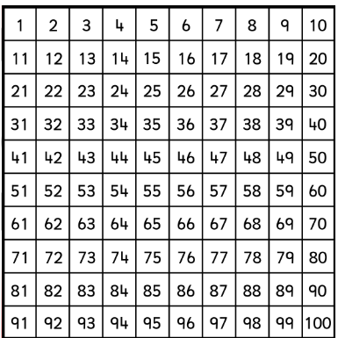
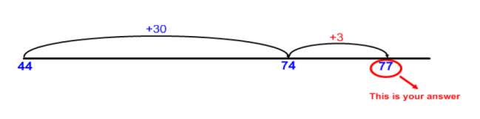
Addition
Add 2 digit number and ones
Add 2 digit number and tens
Use partitioning to add two 2-digit numbers using concrete resources and/or a numbered number line and then progressing to an empty number line.
+10
As we gain confidence with adding on tens and ones, ww should try to combine the jumps on an empty number line.
+1

Slide 8
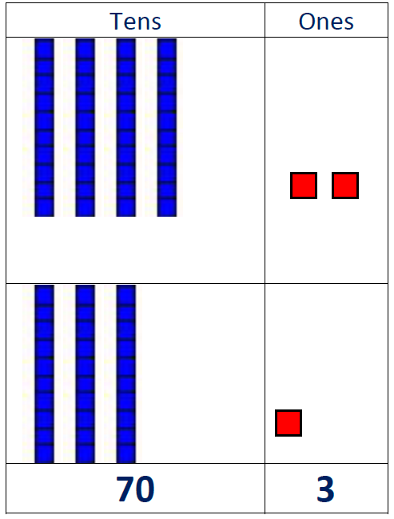
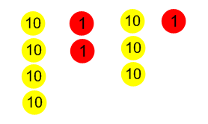
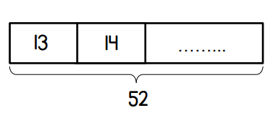
Addition
Use expanded column method with place value resources to support the conceptual understanding of adding numbers up to three digits with no carrying.
42 + 31 = 73
40 + 2
30 + 1
70 + 3
OR
Use the bar model for solving unknown quantities.

Slide 9
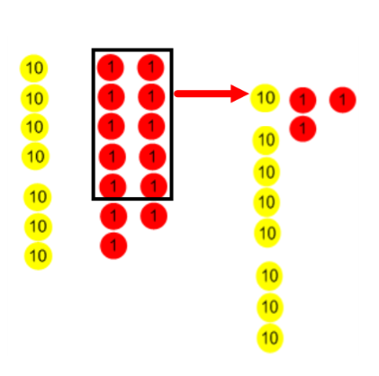
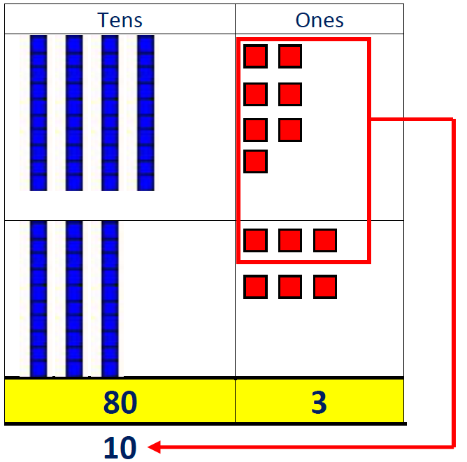
Addition
Progress to using the expanded column method with place value resources to support the conceptual understanding of adding numbers up to three digits with carrying.
47 + 36 = 83
40 + 7
30 + 6
80 + 3
10
OR
Extend to using the expanded column method to add three digit numbers + three digit numbers with carrying.
300 + 60 + 7
100 + 80 + 5
500 + 50 + 2
100 10
Note: The carried ten or carried hundred is just as important as any other number, therefore, it should be written as clear and as large as any other number, and placed at the bottom of the column in which it is to be added.
367 + 185 = 552

Slide 10
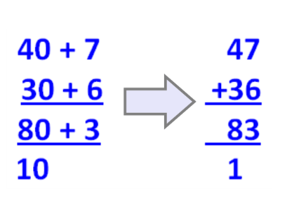
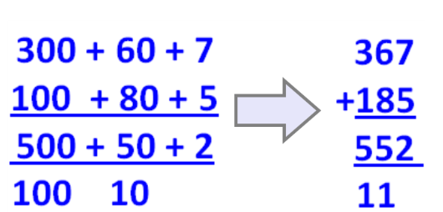
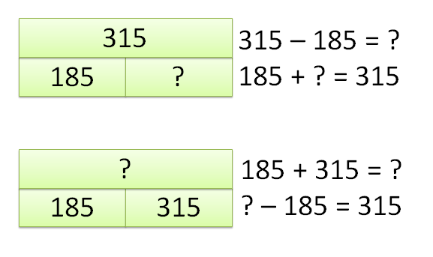
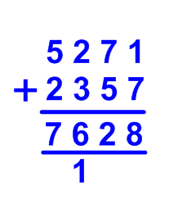
Addition
Note: The carried ten or carried hundred is just as important as any other number, therefore, it should be written as clear and as large as any other number, and placed at the bottom of the column in which it is to be added.
How expanded method links to compact column addition method.
Use the bar model for solving unknown quantities.
Adding numbers up to 4 digits using compact column addition method.

Slide 11
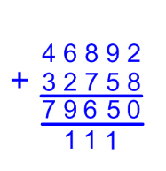
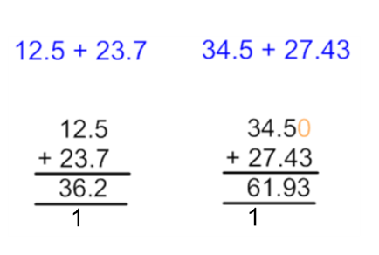
Addition
Adding numbers using compact column addition method. Note: The carried ten, hundred, thousand is just as important as any other number, therefore, it should be written as clear and as large as any other number, and placed at the bottom of the column in which it is to be added.
When adding decimals, it is essential that the decimal point does not move and kept in line.

Slide 12
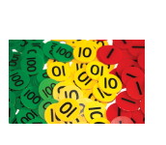
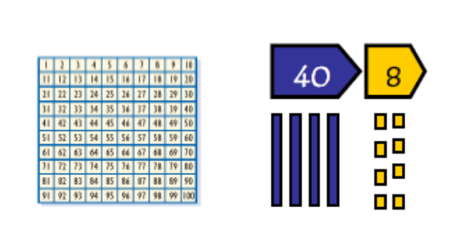
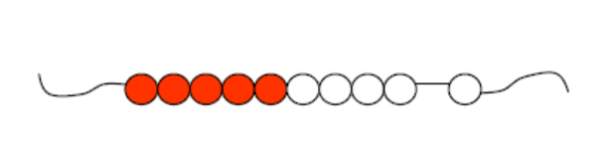
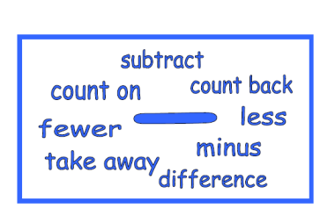
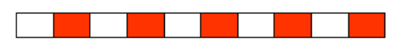
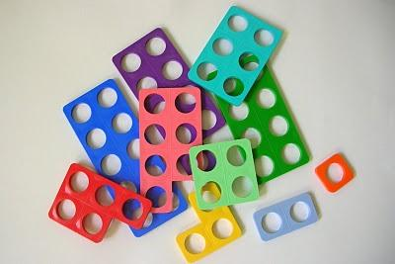
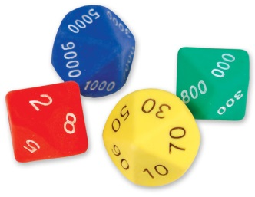
Subtraction

Slide 13
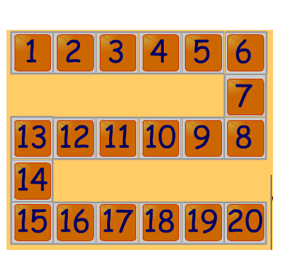
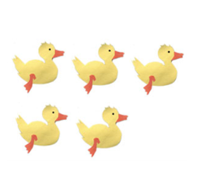
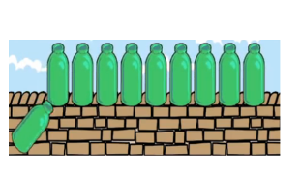
Subtraction
Begin to count backwards in familiar contexts such as number rhymes or stories.
5 little ducks went swimming one day...
Say which number is one less than a given number using a number line or number track to 20.
Begin to relate subtraction to ‘taking away’ using concrete objects and role play.
Three teddies take away two teddies leaves one teddy
10 Green Bottles sitting on the wall ...
If I take away four shells there are six left
Count backwards along a number line to ‘take away’

Slide 14
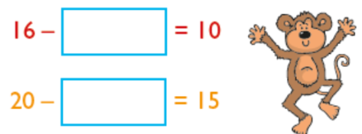
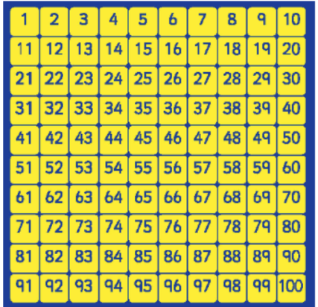

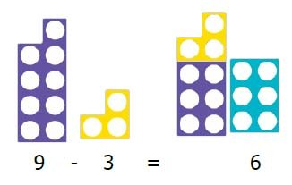
Subtraction
Understand subtraction as take away. Use practical resources, pictorial representations, role play, stories and rhymes.
Use number bonds and related subtraction facts within 20.
Count back in ones and find one less than a given number.

Slide 15
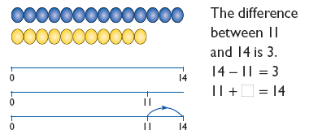
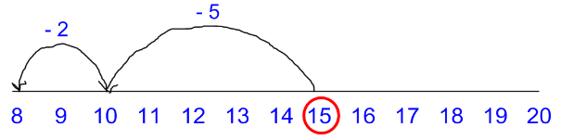
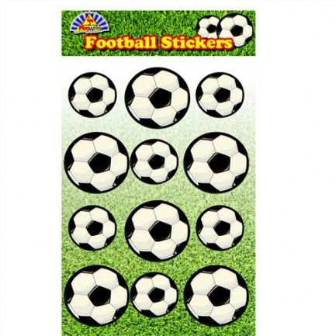
Subtractin
Counting on should only be used when the language used is ‘find the difference’, ‘difference between’ and ‘distance between’.
Use number line to support the subtraction of numbers. Know and use strategy of counting back to subtract one-digit and two-digit numbers to 20.
Solve one-step problems using concrete objects
and pictorial representations.
15 – 7 = 8
Begin to use the - and = signs to write calculations in a number sentence.
Dan has 12 football stickers.
He gives 4 to Ben.
How many stickers does he have left?
12
- 4 =
8

Slide 16
Subtraction
Memorise and reason with number facts to 20 in several forms.
Partition two 2-digit numbers using a variety of models and images.
32p
Use the bar model for solving unknown quantities.

Slide 17
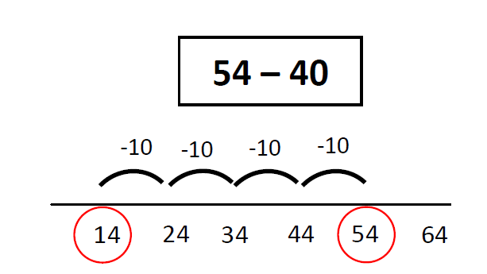
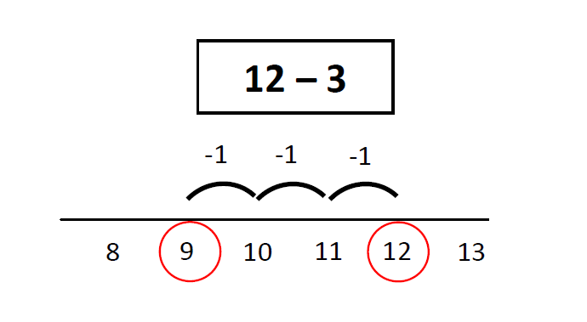
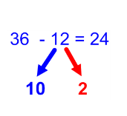
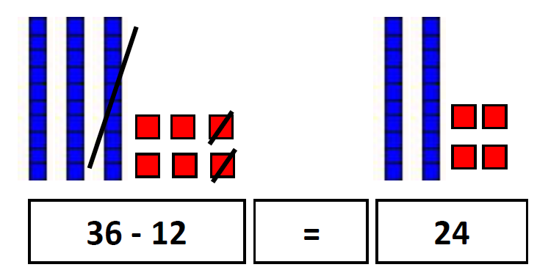
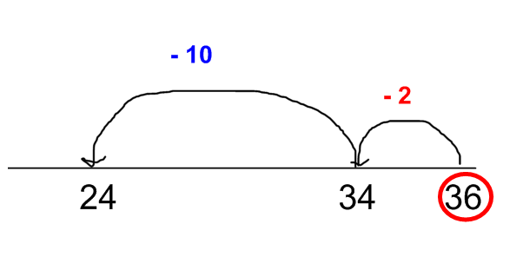
Subtraction
Subtract 2 digit and ones
Subtract 2 digit and tens
Use partitioning to subtract two 2-digit numbers using concrete resources and/or a numbered number line and then progressing to an empty number line.
-10
-1
OR

Slide 18

Subtraction
Use expanded column method with place value resources to support the conceptual understanding of subtracting numbers with up to three digits with no exchanging.
42 - 11 = 31
40 + 2
10 + 1
30 + 1
-
=
OR

Slide 19




Subtraction
Progress to using the expanded column method with place value resources to support the conceptual understanding of subtracting numbers with up to three digits with exchanging tens and/or hundreds.
74 - 27 = 47
In this example to subtract 7 ones from 4 ones we need to exchange a ten for ten ones. We now can subtract 7 ones from 14 ones.
OR
Extend to using the expanded column method to subtract three digit numbers from three digit numbers.
Note: The exchanged ten or hundred is just as important as any other number, therefore, it should be written as clear and as large as any other number, and placed at the top of the column which has been adjusted.
537 – 254 = 283

Slide 20




Subtraction
How expanded method links to compact column subtraction method.
Note: The exchanged ten or hundred is just as important as any other number, therefore, it should be written as clear and as large as any other number, and placed at the top of the column which has been adjusted.
Subtracting numbers up to 4 digits using compact column subtraction method.

Slide 21



Subtracting numbers using compact column subtraction method. Note: The exchanged ten or hundred is just as important as any other number. Therefore, it should be written as clear and as large as any other number, and placed at the top of the column which has been adjusted.
Subtraction
When subtracting decimals, it is essential that the decimal point does not move and is kept in line.
Where necessary, a zero should be added as a place holder.
0

