Slide 1
GRACE ACADEMY
CLASS – 2.
SUBJECT – PHONETICS.
TOPIC – Mrs. FORGETFUL & PAST ENDINGS.

Slide 2
CONTENTS:
LEARNING OUTCOMES.
INTRODUCTION.
DIFFERENCE BETWEEN PAST AND PRESENT TENSE.
DESCRIBING MRS. FORGETFUL.
PAST ENDINGS.
WORKSHEET OF PAST ENDINGS.

Slide 3
LEARNING OUTCOMES:
Students will be able to:
identify the difference between past sentence and present sentence.
create new sentences in past tense .
discuss in groups what they did yesterday and what they did today.
understand that a past word ends with an –ed word.

Slide 4
INTRODUCTION.
1). Mrs. Forgetful.
2). Helping Mrs. Forgetful remember her past activities.
3). Past endings using the word –ed.

Slide 5
Difference between past tense and present tense.
The present tense is used to describe things that are happening right now, or things that are continuous.
Example : I am writing a letter now, he is going to the market.
The past tense is used to describe things that have already happened.
Example: earlier in the day, last week, five years ago.
WHEREAS

Slide 6
FORGETFUL MEANS ALWAYS FORGETTING.
AND FORGET MEANS NOT REMEMBERING.
AND PEOPLE FORGET BECAUSE THEY ARE THINKING ABOUT OTHER THINGS.

Slide 7
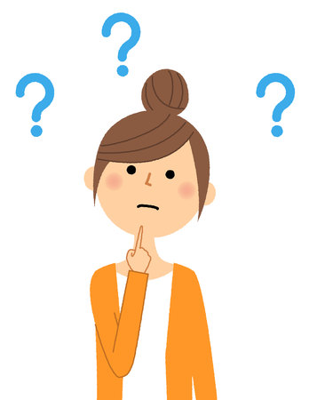
MRS. FORGETFUL.

Slide 8
MRS. FORGETFUL
Here we see a lady by the name Mrs. Forgetful.
She is called Forgetful because she keeps on forgetting things.
She doesn’t remember the things she did in the past.

Slide 9
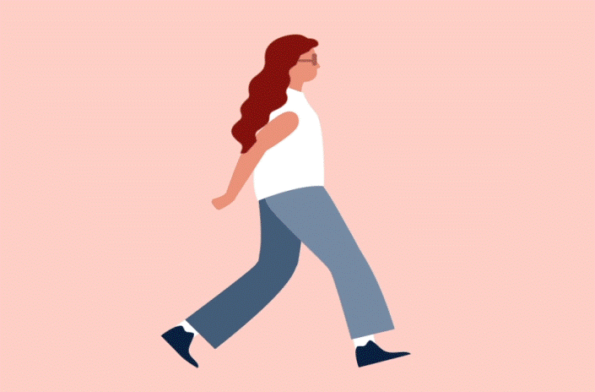
Read Mrs. Forgetful’s questions with a friend. Take turns to say the answers.
Today I am walking to the shops. Where did I walk yesterday?
Yesterday you walked to the park.

Slide 10
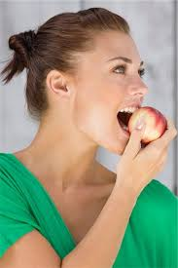
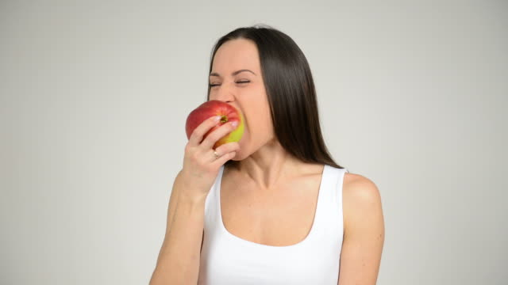
Today I am eating peach. What did I eat yesterday?

Slide 11
Today I am drinking milk.
What did I drink yesterday?

Slide 12
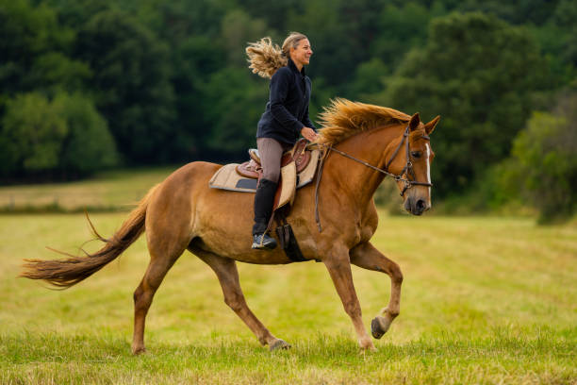
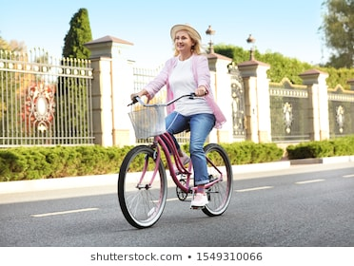
Today I am riding a horse.
What did I ride yesterday?

Slide 13
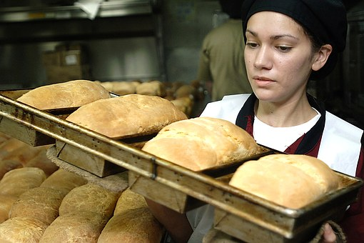
Today I am baking bread.
What did I bake yesterday?

Slide 14
* NOW TRY THIS:
Tell you friends what you are doing today.
Say what you did yesterday.

Slide 15
PAST ENDINGS.
Reading the words:
LIFTED
SHOUTED
TALKED
KICKED
POSTED
DASHED
MIXED
TASTED
COUNTED
BOUNCED
JUMPED
FAINTED

Slide 16
THIS IS A VIDEO PRESENTATION IN YOUTUBE TO UNDERSTAND THE –ED ENDINGS PROPERLY.
LISTEN TO THE –ED ENDINGS.
https://youtu.be/4_s12MkuvFQ.

Slide 17
WRITE THESE WORDS UNDER THE ENDING THEY SOUND LIKE:
Lifted, Posted, Talked, Kicked, Shouted, Dashed, Mixed, Tasted, Counted, Bounced, Jumped, Fainted, Looked, Rushed, Trusted.
Mended ( ed) | Crashed (ed)

